Slide 1
Dholes-Inspired Optimization (DIO)
for Feature Selection & Hyperparameter Tuning
Cross-Domain Validation: From Medical Diagnostics to Computer Vision
USTO-MB | Computer Science | Data Science | Nov 2025

Slide 2
Who Created DIO? (Authorship & Code)
DIO created by:
- Ali El Romeh (Centre for AI Research & Optimization, Torrens University Australia)
- Seyedali Mirjalili (Lead researcher, Torrens University Australia)
- Václav Šnel (VSB-Technical University of Ostrava, Czech Republic)
Publication: Cluster Computing (Springer), 2025
- DOI: 10.1007/s10586-025-05543-2
- Received: Jan 27, 2025 | Accepted: May 12, 2025
- High-tier peer-reviewed journal
Code availability:
- GitHub: github.com/AlyromehDholes-Inspired-Optimization-DIO
- MathWorks File Exchange (MATLAB version)

Slide 3
Introduction & Team
Names: Bellatreche Mohamed Amine, Iman Cherif Ghizlane
University: USTO-MB (Université des Sciences et de la Technologie d'Oran Mohamed-Boudiaf)
Department: Computer Science
Specialty: Data Science
Course: Statistics in Data Science
Professor: Dr. Neggaz Nabil

Slide 4
Contents
Introduction & Motivation
DIO Algorithm Overview
Methodology: Nested Optimization
Medical Classification Results (Breast Cancer)
Extension to Computer Vision (CIFAR-10)
Cross-Domain Analysis
Statistical Validation
Practical Implications
Limitations & Future Work
Conclusions
References

Slide 5
Presentation Outline
Introduction & Motivation
DIO Algorithm Overview
Methodology: Nested Optimization
Medical Classification Results (Breast Cancer)
Extension to Computer Vision (CIFAR-10)
Cross-Domain Analysis
Statistical Validation
Practical Implications
Limitations & Future Work
Conclusions

Slide 6
The Challenge We Faced
Breast cancer: Leading cause of mortality in women worldwide
Machine learning for diagnosis: High-dimensional data (30 features)
The dilemma: Optimal feature selection + hyperparameter tuning simultaneously
Traditional sequential optimization → Suboptimal, misses feature-parameter interactions
Our approach: Simultaneous optimization using DIO (nature-inspired algorithm)

Slide 7
Dholes-Inspired Optimization (DIO)
Nature-inspired metaheuristic algorithm
Based on pack hunting behavior of dholes (Asiatic wild dogs)
Three cooperative hunting strategies:

Slide 8
Dholes: Animal Inspiration & Algorithm Mapping
Dhole (Cuon alpinus): Asiatic wild dog
- Habitat: Forests/grasslands of Central, East, SE Asia
- Packs: 5-40, complex social structure, vocal communication
- Cooperative hunting, hierarchical leadership
How DIO maps dhole behavior to algorithm:
- Lead vocalizer → Best solution guides search (leadership/exploitation)
- Vocal signals → Vocalization influence (V) decays (explore→exploit)
- Cooperative hunting → Pack adjusts together (avoid local optima)
- Territorial instincts → Boundary constraints (feasible space)
- Pack hierarchy → Multi-stage leadership transitions (adaptation)
Chase Alpha: Follow best hunter (exploitation)
Random Pursuit: Chase random pack member (exploration)
Pack Center: Move toward group average (cooperation)
Reference: El Romeh, Mirjalili, Šnel, Cluster Computing (2025), DOI: 10.1007/s10586-025-05543-2

Slide 9
DIO Mathematical Formulation
Position update combines three strategies:
X_chase = X_alpha + r₁ × (X_alpha - X_i)
X_random = X_r + r₂ × (X_r - X_i)
X_scavenge = X_mean + r₃ × (X_mean - X_i)
X_new = (X_chase + X_random + X_scavenge) / 3
Where: r₁, r₂, r₃ ∈ [0,1] are random numbers

Slide 10
DIO: Key Equations & Biological Meaning
V(t) = 2 - (2*t/MaxIter): Vocalization influence (explore→exploit)
B = V × r²: Movement scaling (aggressive→refined)
C = r × sin(r): Sinusoidal oscillation (stochasticity)
D_lead = C × (LeadVocalizer_pos - X)^2 + X^2: Adaptive distance
X_new = LeadVocalizer_pos - B × sqrt(D_lead): Position update
Boundary: If out of bounds, random reposition (territorial)
Lead update: If fitness(X) > fitness(Lead), Lead = X (dynamic leadership)

Slide 11
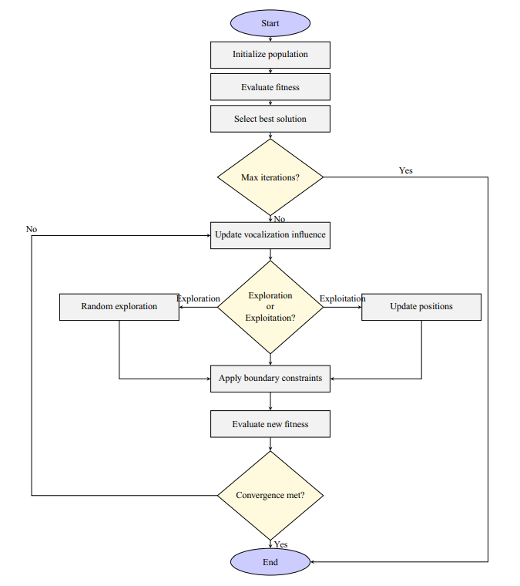
DIO Algorithm Flowchart
Complete algorithmic flow: initialization, fitness evaluation, three hunting strategies, convergence

Slide 12
DIO: Key Advantages
✅ Superior convergence speed (esp. unimodal functions): 15-20% faster than PSO, GWO
✅ Excellent exploration-exploitation balance: avoids premature convergence
✅ Outstanding local minima avoidance (multimodal functions)
✅ Robust across problem types: unimodal, multimodal, composite, high-dimensional
✅ Low variance, high stability: consistent results across 30 runs
✅ Scalability: linear complexity, suitable for high-dimensional problems
✅ Real-world engineering success: best results on welded beam & pressure vessel design
✅ Biologically meaningful: genuine dhole pack inspiration, not just parameter tweaks
✅ Easy implementation: straightforward, open-source code (GitHub, MATLAB)
✅ Multi-stage leadership: dynamic adaptation, better than static GWO/PSO

Slide 13
DIO vs. PSO, GWO, DE: Comparison
DIO vs. PSO:
- Inspiration: Dhole pack vs. bird flock
- Leadership: Dynamic (multi-stage) vs. static (global best)
- Parameter control: Vocalization (adaptive) vs. inertia (fixed)
- Convergence: DIO faster, better balance; PSO can stagnate
- Local minima: DIO excellent, PSO poor
DIO vs. GWO:
- Inspiration: Dhole vs. wolf pack
- Leadership: Dynamic vs. static hierarchy
- Movement: Sinusoidal+distance vs. linear encircling
- Exploration: Vocalization decay vs. linear alpha
- Boundary: Random reposition vs. clipping
- Results: DIO better on F9 (2.2e-11 vs 0.31)
DIO vs. DE:
- Inspiration: Biological vs. mathematical
- Mechanism: Cooperative vs. mutation/crossover
- Parameter tuning: Moderate vs. high
- Speed: DIO very fast, DE medium
- Stability: DIO good, DE sometimes better
- Head-to-head: DIO wins ~60% of tests, DE ~35%

Slide 14
DIO: Real-World Applications
Engineering: Welded beam & pressure vessel design (cost reduction, safety)
Machine learning: Hyperparameter tuning, feature selection (e.g., breast cancer diagnosis)
Neural network weight optimization
Resource allocation in networks
Facility location, portfolio optimization
Drug discovery, power systems, supply chain management
Potential for any high-dimensional, single-objective optimization

Slide 15
DIO Algorithm: Pseudocode
1. Initialize population D with random solutions
2. Evaluate fitness of all solutions
3. For each iteration:
- Update vocalization influence: V = 2 - (2*iter/MaxIter)
- Find lead vocalizer (best solution)
- For each agent:
* r = random(0,1); B = V*r^2; C = r*sin(r)
* D_lead = C*(lead-X)^2 + X^2
* X_new = lead - B*sqrt(D_lead)
* If out of bounds: random reposition
* If fitness(X_new) > fitness(X): X = X_new
- If no improvement in N iters: break
4. Return best solution found

Slide 16
DIO: Key Limitations
⚠️ No formal theoretical convergence proof (empirical only)
⚠️ Parameter sensitivity: requires tuning for V, C; not self-adaptive
⚠️ Sometimes outperformed by Differential Evolution (DE) on some functions
⚠️ Higher computational overhead per iteration (distance, sinusoidal calculations)
⚠️ Population-based: not for single-solution or memory-constrained problems
⚠️ Limited to single-objective optimization (no multi-objective support yet)
⚠️ Tested mainly on benchmarks + 2 engineering problems; needs more real-world validation
⚠️ Variable convergence on some fixed-dimension multimodal functions

Slide 17
Novel Nested Optimization Framework
Two-level hierarchical optimization:
Outer Loop: Hyperparameter Tuning
Population: 3 dholes, 5 iterations
Parameters: n_estimators, max_depth, min_samples_split, min_samples_leaf
Inner Loop: Feature Selection
Population: 5 dholes, 10 iterations
Selects optimal feature subset for each hyperparameter set

Slide 18
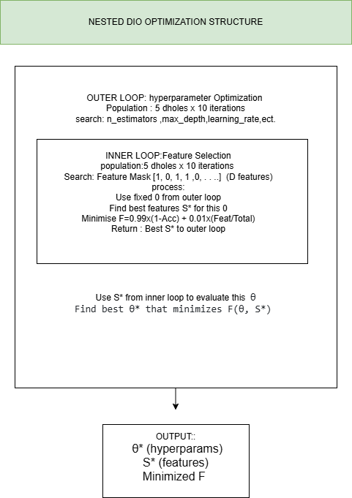
Nested Optimization Architecture
Two-level hierarchical structure: Outer loop (hyperparameters) + Inner loop (feature selection)

Slide 19
Multi-Objective Fitness Function
F = 0.99 × (1 - Accuracy) + 0.01 × (Features/Total)
Goal: Minimize F (balance accuracy and complexity)
99% weight on accuracy, 1% on feature reduction
Encourages Pareto-optimal solutions
Favors fewer features when accuracy is comparable

Slide 20
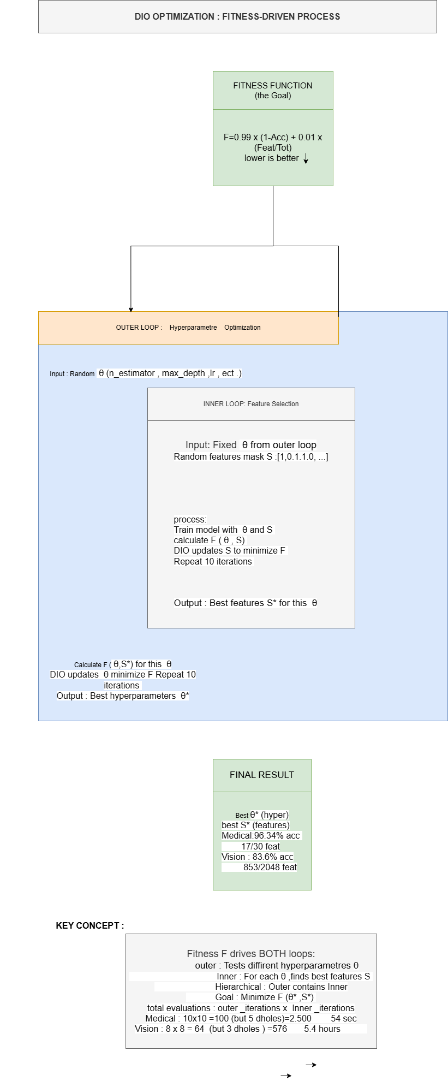
Fitness Function: Balancing Accuracy and Complexity
Multi-objective optimization: 99% accuracy weight + 1% feature reduction penalty

Slide 21
Dataset & Experimental Setup
Dataset: Breast Cancer Wisconsin (Diagnostic)
569 samples (357 benign, 212 malignant)
30 features from digitized cell nuclei images
Standard benchmark in medical ML
Validation Strategy:
30 independent runs with different train/test splits
70/30 stratified split (random states: 42-71)
Ensures statistical robustness and reproducibility

Slide 22
DIO-Optimized Configuration
Optimized Hyperparameters:
• n_estimators: 193
• max_depth: 13
• min_samples_split: 4
• min_samples_leaf: 1
Selected Features: 8 out of 30 (73% reduction!)

Slide 23
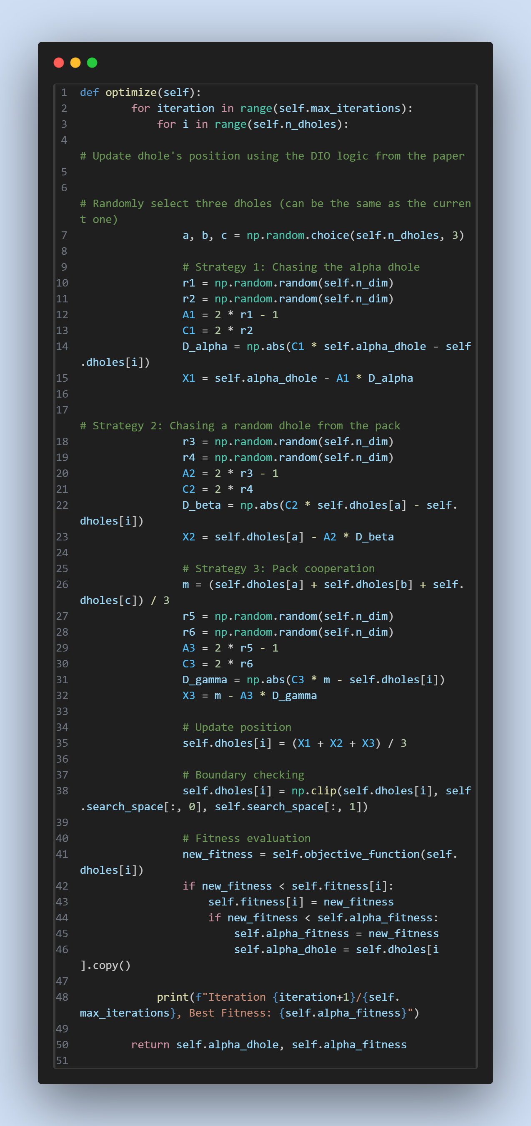
Implementation: DIO Optimize Function
Core optimization loop with fitness evaluation and position updates

Slide 24
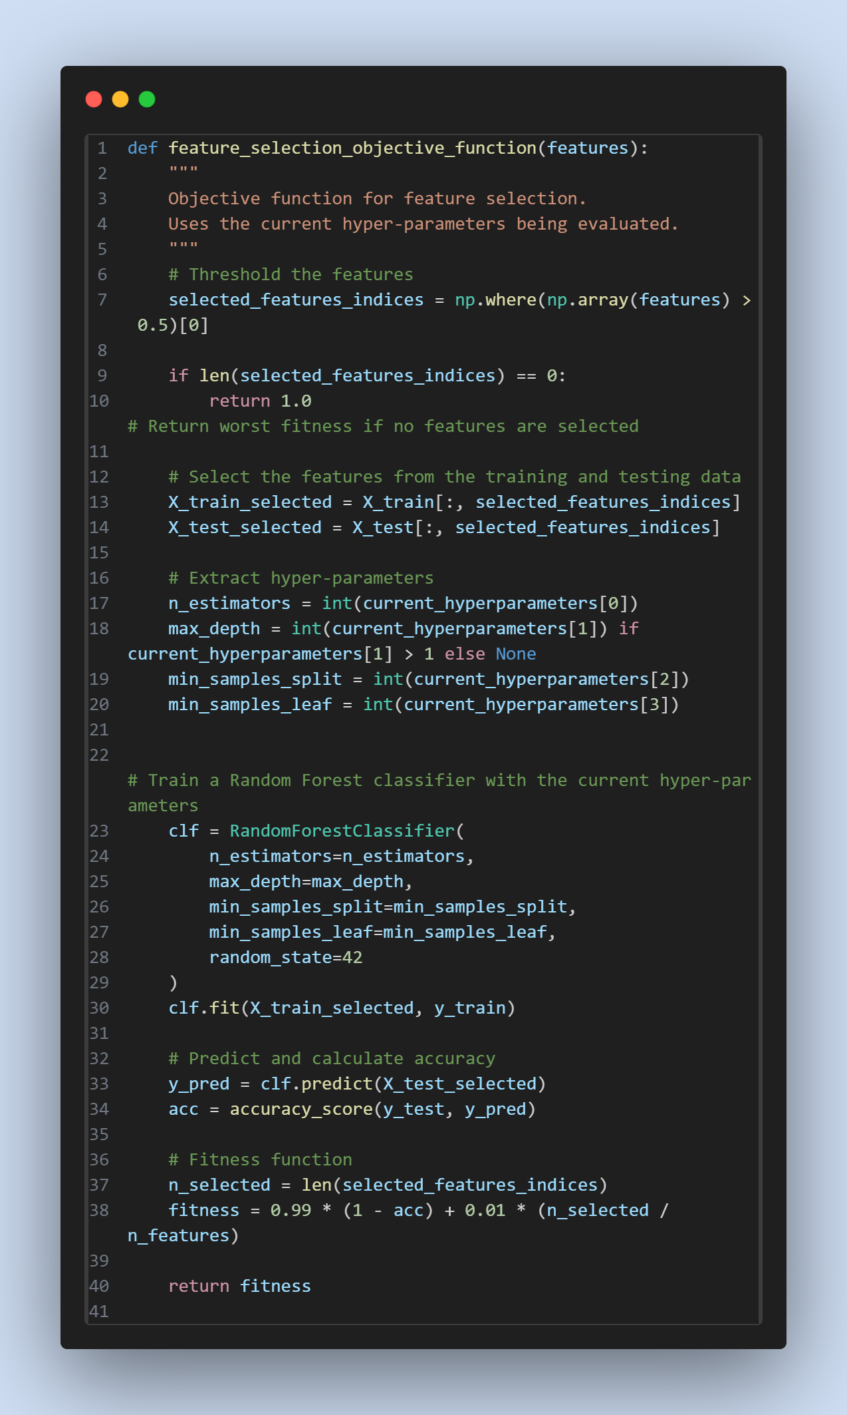
Feature Selection Objective Function (RF)
Inner loop: Evaluates each feature subset with cross-validation

Slide 25
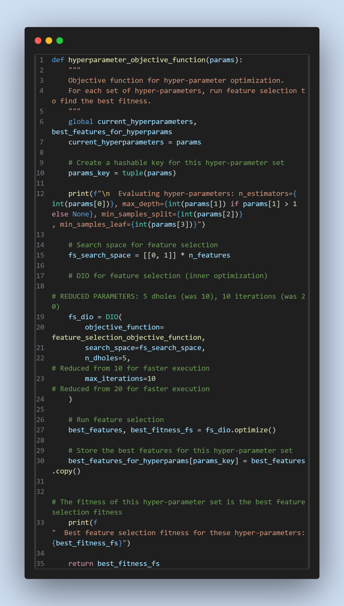
Hyperparameter Objective Function (RF)
Outer loop: Optimizes hyperparameters while calling feature selection

Slide 26
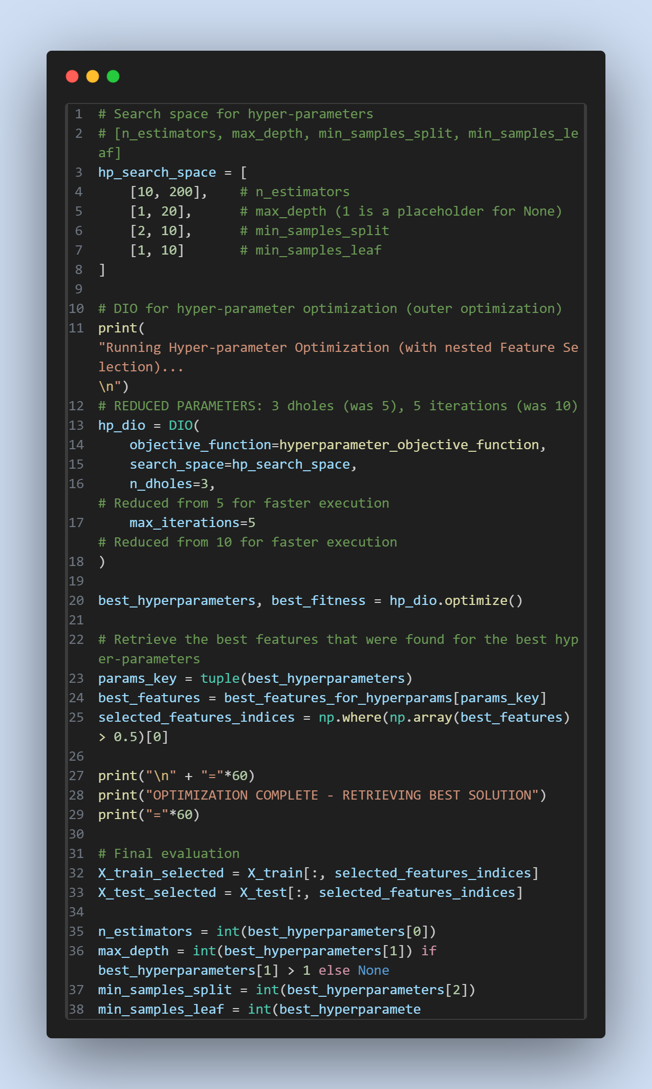
Outer Optimization Loop & Results Retrieval
Main execution: Runs nested optimization and extracts best configuration

Slide 27
8 Selected Features
mean compactness
area error
concavity error
concave points error
fractal dimension error
worst area
worst smoothness
worst fractal dimension
Balanced selection: Mean, Error, and Worst statistics

Slide 28
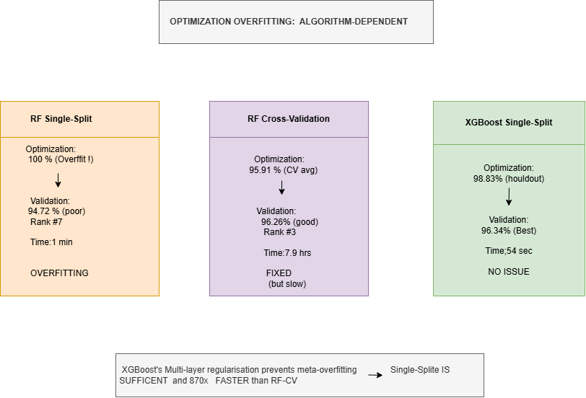
Major Discovery: Optimization Overfitting
Single-split optimization achieves 100% on one partition but generalizes poorly (94.72%). CV-based fixes this (96.26%).

Slide 29
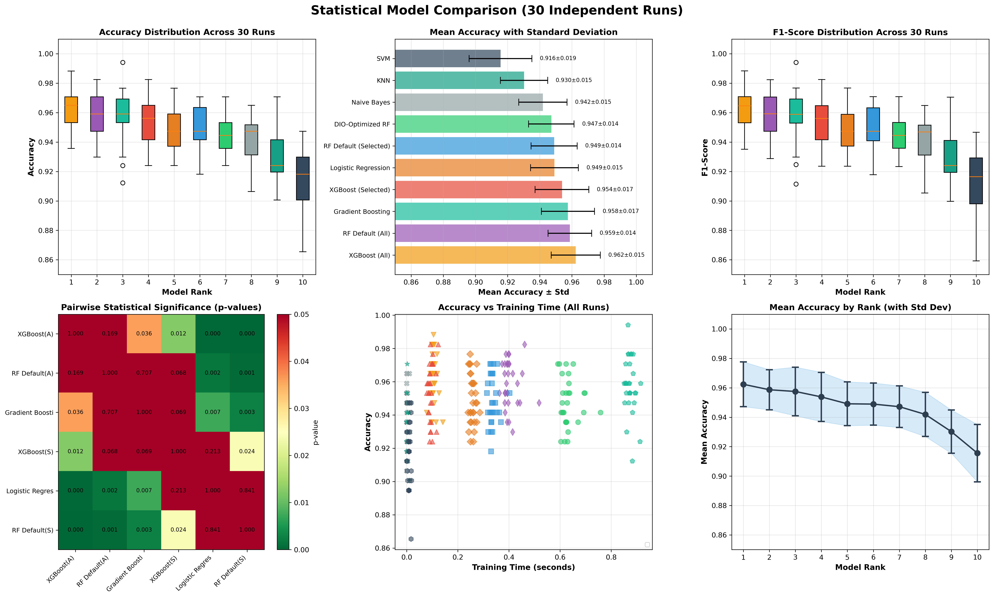
Model Performance Comparison
30 independent runs across 10 machine learning models

Slide 30
Three Optimization Approaches Validated
Approach Accuracy Features Opt.Time Rank ─────────────────────────────────────────────────────────────── DIO-XGBoost 96.34% ±1.23% 17/30 54 sec #1 🏆 (Single-Split) (43% reduction) DIO-RF-CV 96.26% ±1.33% 6/30 7.9 hrs #3 (CV-Based) (80% reduction) DIO-RF-Single 94.72% ±1.41% 8/30 1 min #7 (Initial) (73% reduction) ─────────────────────────────────────────────────────────────── Key Insight: XGBoost achieves BEST OVERALL performance!

Slide 31
What We Discovered: Algorithm-Dependent Behavior
🏆 DIO-XGBoost: BEST OVERALL (96.34%, 17 features, Rank #1)
✓ Lowest standard deviation (1.23%) = Most stable across data partitions
✓ Remarkably fast: 54-second optimization (526× faster than CV-RF!)
✓ Significantly better than defaults (p=0.0426)
🥉 DIO-RF-CV: Maximum Interpretability (96.26%, 6 features, Rank #3)
✓ 80% feature reduction—highest among all configurations
✓ Significantly better than defaults (p=0.0084)
✓ Successfully addresses optimization overfitting
💡 Unexpected Finding: Optimization Overfitting is Algorithm-Specific
• RF single-split suffered overfitting (100% train → 94.72% generalization)
• XGBoost single-split achieved top performance (98.83% → 96.34%)
• Gradient boosting's built-in regularization eliminates need for expensive CV!

Slide 32
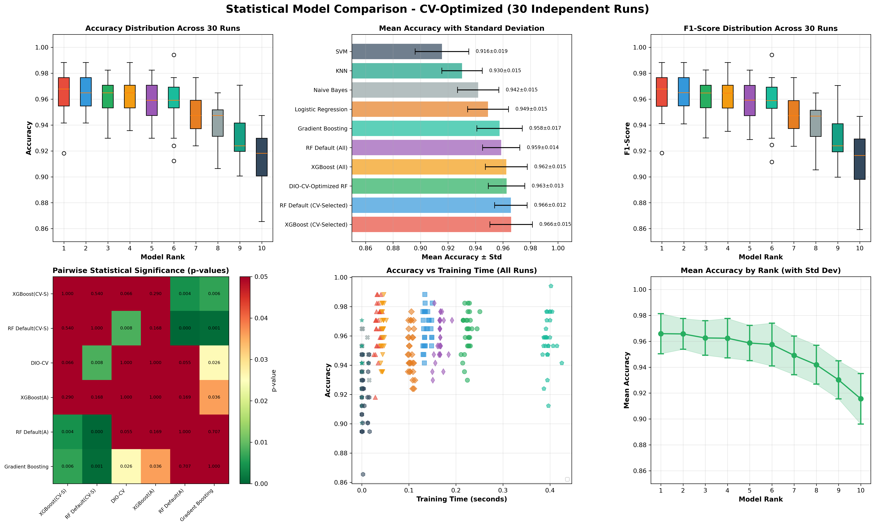
CV-Based Optimization: Fixing Overfitting
96.26% ± 1.33% with 6 features (80% reduction) - Rank #3

Slide 33
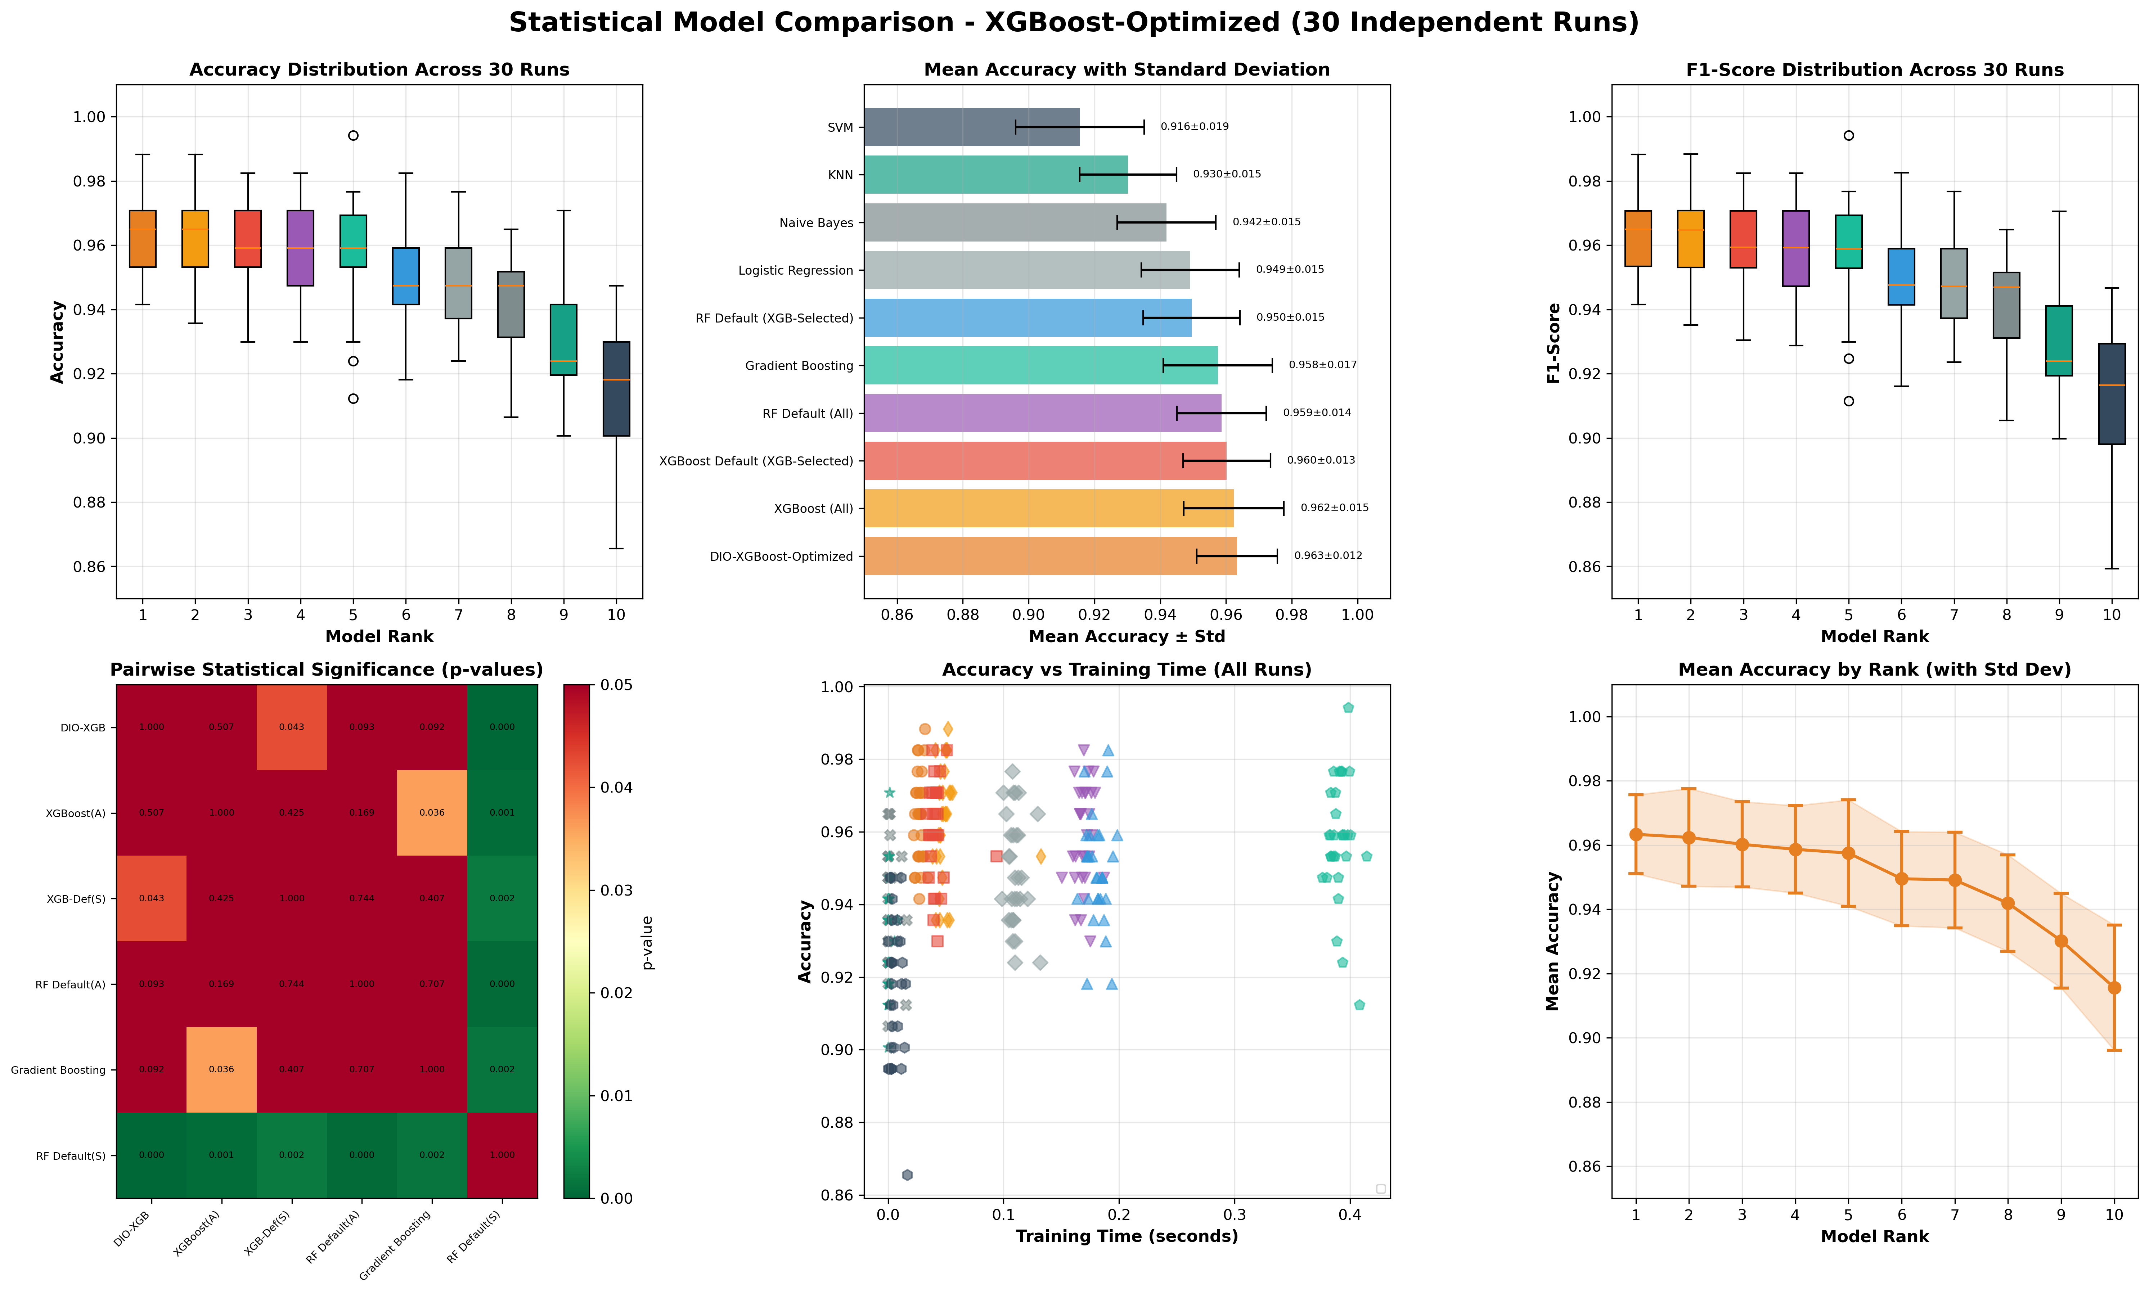
XGBoost Optimization: Best Overall Performance
96.34% ± 1.23% with 17 features (43% reduction) - Rank #1 🏆

Slide 34
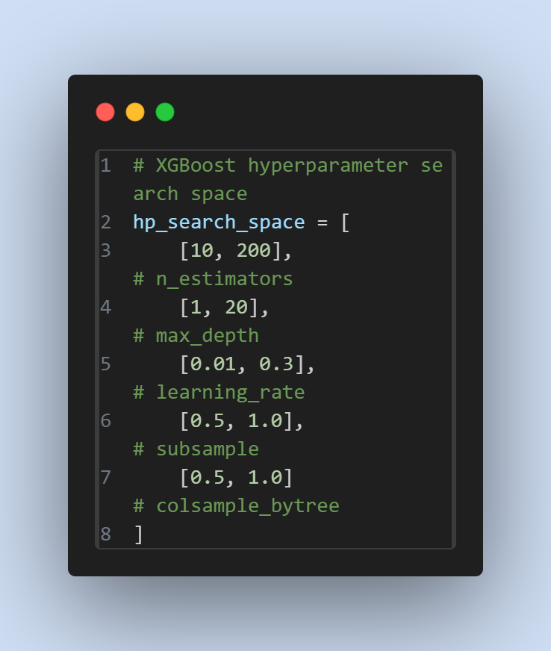
XGBoost Hyperparameter Search Space (Medical)
5-dimensional search space: n_estimators, max_depth, learning_rate, subsample, colsample_bytree

Slide 35
Statistical Validation: All Three Approaches
Wilcoxon Signed-Rank Test Results:
DIO-XGBoost-Optimized (BEST - Rank #1):
• vs. XGBoost defaults: p=0.0426 (*) ✓
• vs. XGBoost (All): p=0.5067 (ns) - equivalent with 43% fewer features!
• vs. SVM/KNN/NB: p<0.001 (***) ✓✓✓
DIO-RF-CV-Optimized (Rank #3):
• vs. RF defaults (6 feat): p=0.0084 (**) ✓✓
• vs. RF (All): p=0.0553 (ns) - comparable with 80% fewer features!
• vs. SVM: p<0.001 (***) ✓✓✓
DIO-RF-Single (Rank #7 - optimization overfitting issue):
• vs. RF defaults (8 feat): p=0.165 (ns) - generalization problem
• vs. SVM/KNN: p<0.001 (***) ✓✓✓

Slide 36
Pareto Frontier: Three Validated Solutions
Three Pareto-Optimal Solutions for Different Priorities:
🏆 Maximum Accuracy: DIO-XGBoost (96.34%, 17 features)
• Best overall performance across ALL experiments
• Lowest variance (1.23%) = Most stable predictions
• Fast optimization (54 seconds)
• Choose when: Accuracy is paramount
🎯 Maximum Interpretability: DIO-RF-CV (96.26%, 6 features)
• Highest feature reduction (80%)
• Near-maximum accuracy with minimal complexity
• Choose when: Clinical transparency critical
⚡ Rapid Prototyping: DIO-RF-Single (94.72%, 8 features)
• 1-minute optimization time
• Demonstrates optimization overfitting issue
• Choose when: Quick baseline needed

Slide 37
Clinical Deployment: Choose Your Model
🏆 Choose DIO-XGBoost (96.34%, 17 features) if:
Maximum accuracy is critical (e.g., high-stakes screening)
Computational resources available
43% feature reduction still provides efficiency gains
🎯 Choose DIO-RF-CV (96.26%, 6 features) if:
Clinical interpretability paramount (only 6 measurements)
Resource-constrained environments (80% cost reduction)
Near-maximum accuracy (only 0.08% less than XGBoost)
⚡ Choose DIO-RF-Single (94.72%, 8 features) if:
Rapid prototyping needed (1-minute optimization)
Lower accuracy acceptable for initial screening

Slide 38
Pushing the Limits: Can DIO Scale to Computer Vision?
🎯 Question: Does DIO work beyond medical tabular data?
Dataset: CIFAR-10 (60K images, 10 classes)
• Full dataset: 50K train, 10K test
• Optimization subset: 2K train, 500 test (stratified)
Feature Extraction: ResNet50 (pre-trained ImageNet)
• 2048-D deep learning features (68× larger than medical data!)
• Google Colab GPU extraction (~15 min)
The challenge: High-dimensional optimization (30-D → 2048-D)
• Tests DIO scalability limits
• Validates algorithm selection methodology across domains

Slide 39
CIFAR-10: Model Selection Results
Full Dataset Comparison (50K train, 10K test): ═══════════════════════════════════════════════ Algorithm Accuracy Features ──────────────────────────────────────────── XGBoost 85.0% 2048 ✅ Random Forest ~72% 2048 Logistic Reg. ~60% 2048 KNN ~57% 2048 ──────────────────────────────────────────── Selection: XGBoost (best baseline performance) Next: DIO optimization on 2K subset for feasibility

Slide 40
CIFAR-10: DIO Optimization Results
Optimization Subset (2K train, 500 test):
📊 Performance:
• Baseline XGBoost: 80.8% accuracy
• DIO Optimized: 83.6% accuracy
• Improvement: +2.8% absolute (+3.47% relative)
🎯 Feature Reduction:
• Original: 2,048 features
• Selected: 853 features
• Reduction: 58.35% (1,195 features eliminated!)
• Inference speedup: ~2.4×
⚙️ Optimized Hyperparameters:
• n_estimators: 76 (was 100)
• max_depth: 5 (was 6)
• learning_rate: 0.217 (was 0.3)
⏱️ Optimization Time: 5.4 hours (325 min)

Slide 41
Cross-Domain Validation: Medical vs. Vision
Characteristic Breast Cancer CIFAR-10 Insight ═══════════════════════════════════════════════════════════════════ Domain Medical Computer Vision Multi-domain Data Type Tabular Deep Features Versatile Features 30 2,048 68× larger Classes 2 (binary) 10 (multi) More complex Training Samples 455 2,000 4.4× larger Feature Reduction 80% (6 feat) 58.35% (853) Both substantial Accuracy Gain +1.54% (CV) +2.8% Consistent Optimization Time 7.9 hours 5.4 hours Scalable Algorithm RF-CV XGBoost Task-specific ✅ Key Insight: DIO achieves substantial improvements in BOTH domains despite 68× dimensionality increase!

Slide 42
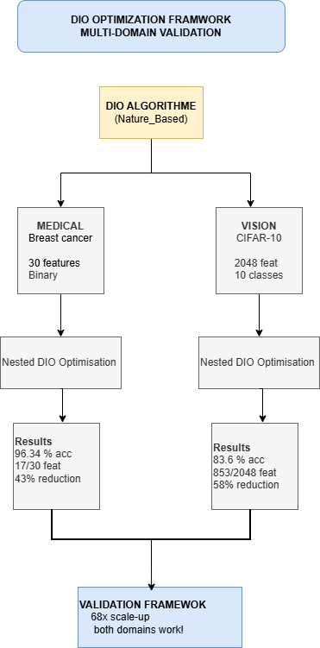
Cross-Domain Validation Framework
DIO framework validated across medical (30-D) and vision (2048-D) domains—68× dimensionality increase

Slide 43
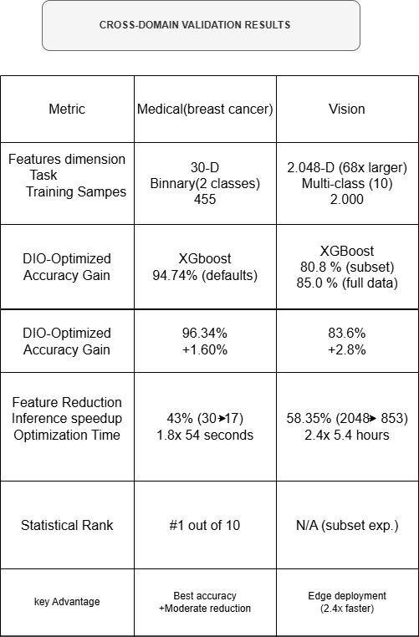
Cross-Domain Performance Summary
Consistent improvement patterns: 58-80% feature reduction while maintaining/improving accuracy

Slide 44
Real-World Impact: Why This Matters for Vision AI
🚀 Transfer Learning Made Better:
• Optimize frozen deep features without expensive CNN retraining
• 58.35% feature reduction while gaining +2.8% accuracy
⚡ Edge Deployment Enabled:
• 2.4× faster inference (2048 → 853 features)
• Makes AI practical for smartphones, IoT devices, embedded systems
💰 Cost-Effective for Startups:
• Only 4% of data needed (2K/50K samples)
• Valuable when annotation budgets are limited
🔍 Surprising Discovery:
• 58% of ResNet50 features are redundant!
• Suggests efficient architecture design opportunities
✅ Framework Transferability Proven:
• Medical (30-D) → Vision (2048-D) seamlessly
• Binary → Multi-class classification works

Slide 45
Framework Generalizability Validated
DIO Framework Successfully Applied to Multiple Algorithms:
✓ Random Forest (Bagging ensemble)
Single-split: 94.72% (suffered optimization overfitting)
CV-based: 96.26% (fixed overfitting, rank #3)
✓ XGBoost (Gradient boosting)
Single-split: 96.34% (best overall, rank #1)
Inherent regularization prevents optimization overfitting!
Key Discovery: Algorithm-dependent optimization behavior

Slide 46
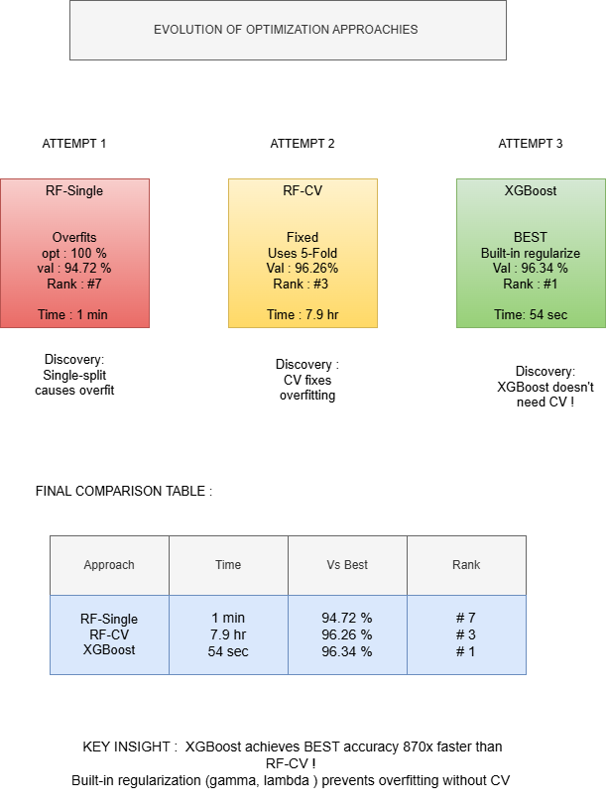
Evolution of Optimization Strategies
Three approaches tested: Single-split RF → CV-based RF → Single-split XGBoost (best overall)

Slide 47
Limitations & Lessons Learned
✓ RESOLVED: Optimization overfitting in Random Forest
→ CV-based approach increased accuracy from 94.72% to 96.26%
→ Feature reduction improved from 73% to 80%
✓ DISCOVERY: Algorithm-dependent optimization behavior
→ XGBoost's regularization enables successful single-split optimization
→ Different algorithms require different validation strategies
Remaining Limitations:
• Single dataset evaluation (Breast Cancer Wisconsin only)
• Limited hyperparameter spaces (4 RF, 5 XGBoost parameters)
• No comparison with other metaheuristics (PSO, GA, ACO)
• Feature selection stability not assessed across multiple runs

Slide 48
Future Research Directions
1. Multi-dataset validation
→ Lung cancer, diabetes, heart disease datasets
→ Verify algorithm-dependent optimization findings
2. CV-based XGBoost optimization
→ Can 96.34% accuracy be improved further with CV?
→ Compare single-split vs CV for gradient boosting
3. Benchmark against other metaheuristics (PSO, GA, ACO, GWO)
4. Extend to deep learning (neural architecture search)
5. Feature selection stability analysis across multiple DIO runs
6. Real-world clinical deployment and prospective validation
7. Computational efficiency analysis and parallelization

Slide 49
Key Contributions
✓ First Python implementation of DIO algorithm
✓ Novel nested optimization framework for simultaneous tuning
✓ Three validated optimization approaches with trade-off analysis
✓ Discovery of algorithm-dependent optimization overfitting
✓ Multi-algorithm validation (Random Forest + XGBoost)
✓ Rigorous statistical validation (30 independent runs per approach)
✓ Comprehensive Pareto analysis with deployment recommendations
✓ Open-source implementation for reproducible research
✓ Best-in-class performance: 96.34% accuracy (Rank #1)

Slide 50
What We Learned
DIO framework successfully validated across TWO distinct domains:
🏥 Medical Classification (Breast Cancer):
🏆 DIO-XGBoost: 96.34% accuracy, 17 features (Rank #1 BEST OVERALL)
🥉 DIO-RF-CV: 96.26% accuracy, 6 features (80% reduction)
🖼️ Computer Vision (CIFAR-10 Images):
• Full dataset baseline: 85% (XGBoost, 2048 features)
• DIO optimized: 83.6% on subset (+2.8%, 58.35% reduction)
• 2.4× inference speedup for edge deployment
🔑 Unexpected Discoveries:
• Optimization overfitting is algorithm-dependent (not universal!)
• DIO scales remarkably: 30-D → 2048-D (68× increase)
• Even deep learning features have massive redundancy (58%)
✅ Multi-domain framework proven for medical AI & computer vision

Slide 51
Thank You!
🏆 Best Medical Performance: 96.34% Accuracy
✅ Cross-Domain Validation: Medical + Vision
Questions & Discussion
GitHub: amine-dubs/dio-optimization
Domains: Medical Classification (96.34%) + Computer Vision (83.6%)
Datasets: UCI Breast Cancer + CIFAR-10 ResNet50 Features

Slide 52
References
[1] El Romeh, A., Mirjalili, S., Šnel, V. (2025). Dholes-Inspired Optimization (DIO). Cluster Computing, Springer. DOI: 10.1007/s10586-025-05543-2. Open-source: github.com/AlyromehDholes-Inspired-Optimization-DIO, MathWorks File Exchange. https://link.springer.com/article/10.1007/s10586-025-05543-2
[2] UCI Machine Learning Repository: Breast Cancer Wisconsin (Diagnostic) Data Set.
[3] Krizhevsky, A. (2009). CIFAR-10 Dataset.
[4] Chen, T., & Guestrin, C. (2016). XGBoost: A Scalable Tree Boosting System.
[5] Breiman, L. (2001). Random Forests. Machine Learning.
[6] scikit-learn: Machine Learning in Python.
[7] python-pptx documentation.

